Slide 1

Airport Slots Utilization Management
Eng. Mazen Adel Abuljadayel
Mazoon33@Hotmail.com
0569130960

Slide 2
Table of Content
Design Introduction
Data
MVP
Visualizations
Algorithms
Tools

Slide 3
Design Introduction
Air transport plays a significant role for the Saudi Arabia Economy, the rapid growth of demand for air transport services, along with political, physical and institutional constraints on building new airport Slot Capacity.
This Design Model aims to provide a critical declared the slot utilized capacity modelling and Estimated Revenue Missed behind By identifying gaps
Data Science Question:
1- Are Airport Slot Management operating and utilized with high effectiveness & efficiency?
2- How much losing revenue if Airports Slot Management not utilized well?
Objectives to figurehead:
-To Increase Air Traffic Movement.
-To Targeting Opportunities for Tourisms to Visit KSA.
-To Compute advantages by gaining more Market Shared.
-To Increase Saudi Airports Revenue.

Slide 4
Data
Our Dataset aiming 10,000+ data points and 40+ features so that can be allowing us to build a robust model with interesting feature engineering and selection challenges.
Lets start focusing on the below fetasured and see can we answer the Data Sciences Question ?
features | Discerptions
ID | Unique Identifier
Airport_Code | The IATA Airport Code
Flights_Rev | The Flights Revenue
Slot_CAP | The Airport Slot Capacity
Slot_Price | The Airport Slot Standard Price

Slide 5
MVP
The core steps effective in this project development is the amount of work address the Data Science key questions/purpose.
The results from a functional baseline model that address the central project purpose as below:
1- Are Airport Slot Management operating and utilized with high effectiveness & efficiency?
- We predicted there are 1011 Free Slot per month not Utilized. This give us a quick view to manage the slot next month or seasons with high effectiveness & efficiency based on the flight movement behaviour and the left free slot.
2- How much losing revenue if Airports Slot Management not utilized well?
- We Found there are 27,525,000 SAR Revenue Miss per month by the weakness of managing the slot management process.

Slide 6
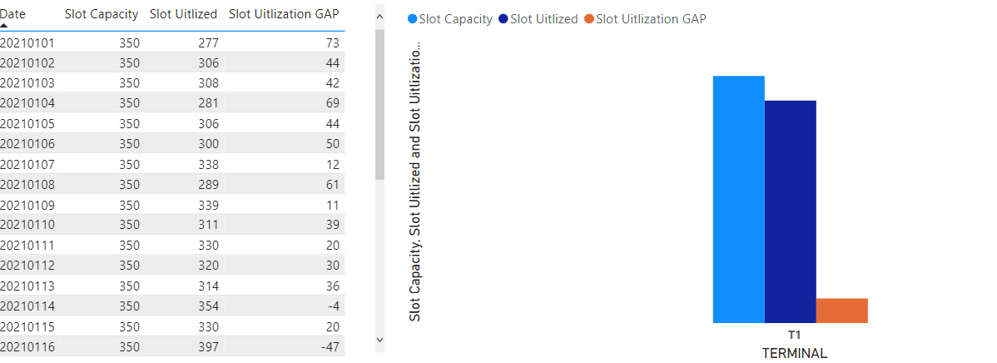
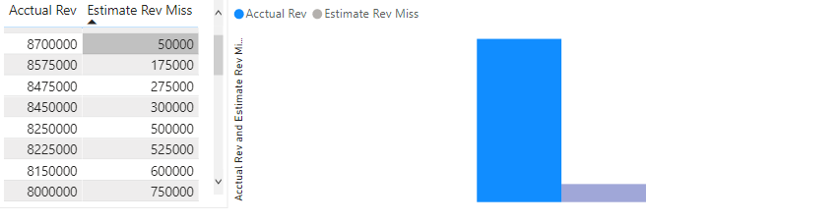
Visualizations
Airport Slot Utilization
Revenue Missed

Slide 7
Algorithms
In the Project we have been used many Algorithms models for training , Validated and testing the score model performance.
Linear Regression validation Score 100% .
Ride Regression validation Score 100%.
Degree polynomial Regression validation Score 100%.
Linear Regression Test Score 100%.
Decision Tree Score 43%.
Random Forest Score 100%.

Slide 8
Tools
Jupiter Notebook.
Panda & Numpy library.
Matplotlib.pyplotLinear & seaborn.
Sklearn.linear_model
Sklearn.model_selection
Sklearn.preprocessing.
Sklearn.tree.
sklearn.ensemble.
Microsoft Power BI Desktop.
Oracle DB.

